Slide 1
CORDEX progress and the need of high-resolution observational datasets
Grigory Nikulin
Swedish Meteorological and Hydrological Institute

Slide 2
Ensembles of regional climate simulations
Large ensembles of regional climate simulations:
PRUDENCE (Europe) – about 11 RCMs
http://prudence.dmi.dk/
ENSEMBLES (Europe) - about 20 RCMs
http://ensemblesrt3.dmi.dk/
NARCCAP (North America) - 6 RCMs
http://www.narccap.ucar.edu/
CLARIS (South America) - 5 RCMs
http://www.claris-eu.org/
ENSEMBLES-AMMA (West Africa) - 10 RCMs
http://ensemblesrt3.dmi.dk/
All these projects have substantially contributed to regional climate studies but: different experiments, protocols, output lists, standards etc.

Slide 3
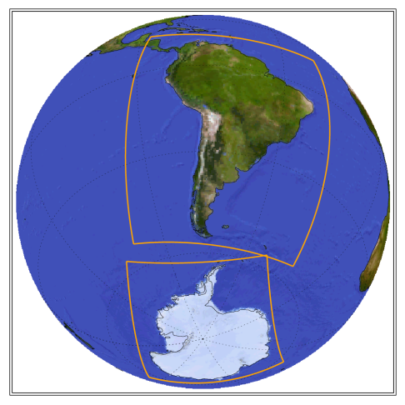
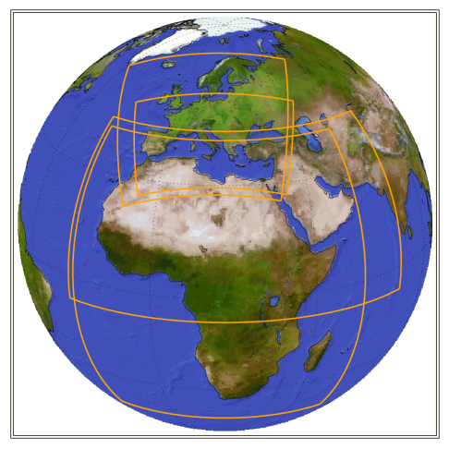
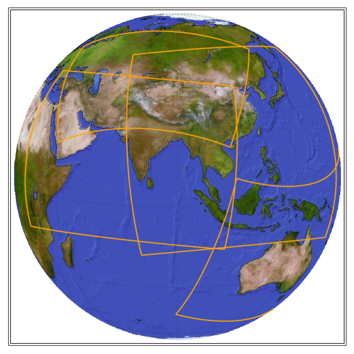
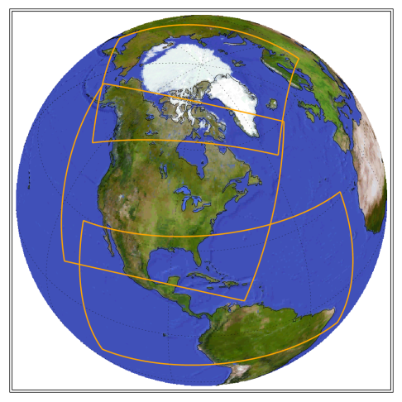
CORDEX initiative
Coordinated Regional Downscaling Experiment
sponsored by the World Climate Research Programme
http://wcrp-cordex.ipsl.jussieu.fr/
Coordinate high-resolution Regional Climate Modeling
(unified protocols, experiments, format, variables etc.)
Provide a set of high-resolution Regional Climate Scenarios
for the majority of land-regions of the globe
Make these data sets available and useable to the impact
and adaptation communities
13 CORDEX Domains defined ( one more is coming)

Slide 4
CORDEX: Sampling the sources of uncertainty
Multiple regional
models
Multiple global
models
Uncertainty in
regional climate
projection
Emission/
Concentration
Scenarios
Region
Internal variability
(Multiple realizations)
Multiple downscaling
methods

Slide 5
CORDEX Phase I experiment design
Model Evaluation
Framework
Climate Projection
Framework
Multiple regions (Initial focus on Africa)
50km resolution (higher in some regions, Europe: 12km)
ERA-Interim
1989-2008
later: 1979-2010
Multiple CMIP6 AOGCMs
Historical (1950-2005)
RCP4.5, RCP8.5 (2006-2100)
Regional Analysis
Regional Databanks
ESGF

Slide 6
Number of groups in the CORDEX domains
CORDEX domain | ~ Number of groups involved
Europe | 27
Africa | 15
Mediterranean | 12
Arctic | 10
South America | 10
South East Asia | 9
MENA | 8
North America | 6-8
Central America | 6
East Asia | 4-5
Australasia | 4
South Asia | 4
Antarctic | 2 (+4 groups coming)
Central Asia | 1

Slide 7
Establishing CORDEX archiving
the first idea was about data portals like in ENSEMBLES (http://ensemblesrt3.dmi.dk/)
work begun in 2009-2010; CORDEX specs are built on CMIP5 as much as possible, as well as on experience gained from the NARCCAP and ENSEMBLES projects
pretty soon benefits of geographically-distributed, metadata-based searchable archives as the Earth System Grid Federation (ESGF) for CMIP5 become evident
the main focus is on ESGF now, although other CORDEX data portals also exist (CORDEX-ESGF was delayed)
  Med-CORDEX (MED): http://www.medcordex.eu
  East Asia CORDEX (EAS) http://cordex-ea.climate.go.kr
  South Asia CORDEX (WAS) http://cccr.tropmet.res.in/cordex
  CCCma (Canada), only CanRCM4 http://www.cccma.ec.gc.ca

Slide 8







CORDEX-ESGF team
publication of CORDEX simulations on ESGF is an joint effort of several European groups with coordination by the IS-ENES2 FP7 project
Martin Juckes and Stephen Pascoe (BADC, UK)
Ole B. Christensen (DMI, Denmark)
Stephanie Legutke and Stephan Kindermann (DKRZ, Germany)
Sebastien Denvil (IPSL, France)
Grigory Nikulin and Michael Kolax (SMHI, Sweden)
Prashanth Dwarakanath and Torgny Faxén (NSC-LIU, Sweden)
and many more ….

Slide 9
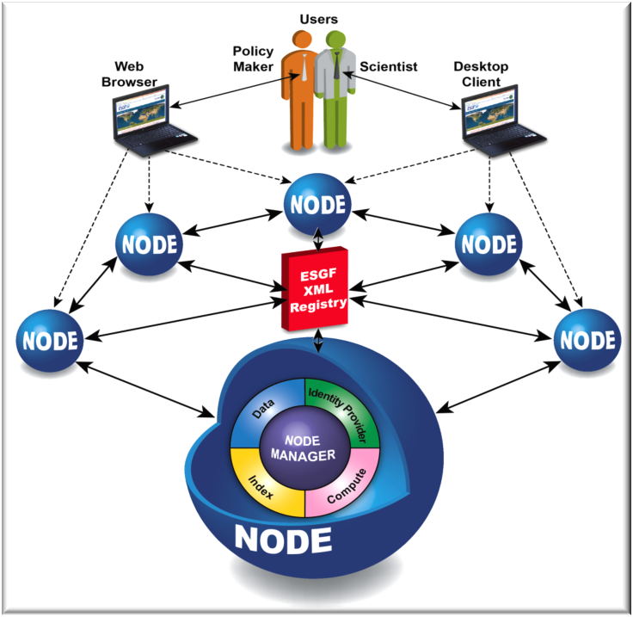
ESGF
an international collaboration for handling climate science data
Peer-To-Peer architecture(p2p): geographically-distributed, decentralized database (many data nodes, no central archive)
metadata-based search (model names, experiments, frequency etc.)
http://esgf.org

Slide 10
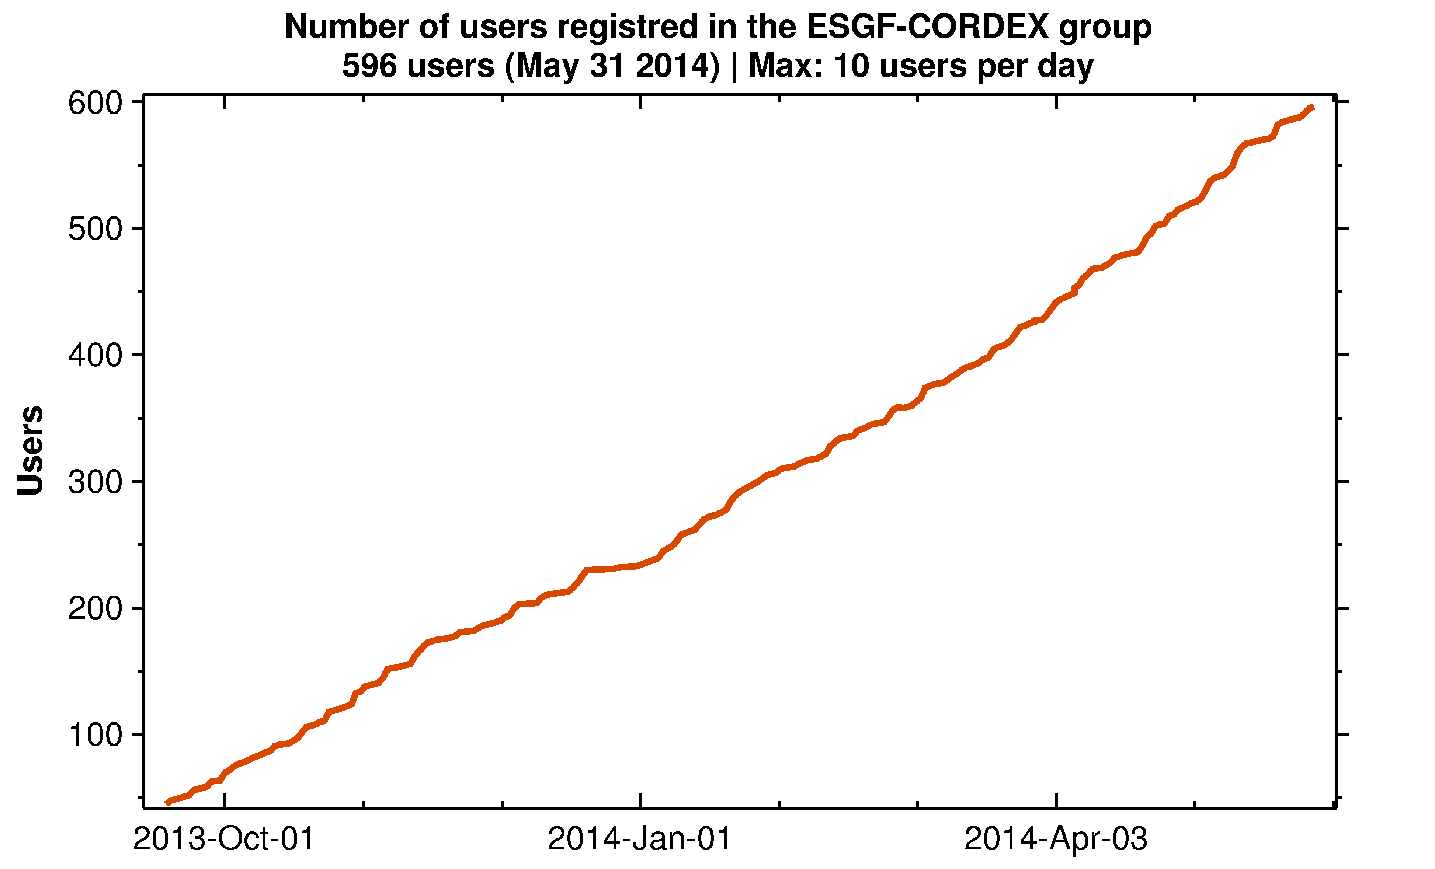
CORDEX-ESGF in operation
CORDEX-ESGF is in operation since mid September 2013
now ESGF provides the same interface for both global (CMIP5) and regional (CORDEX) climate simulations
596 users in the CORDEX-ESGF group (31 May 2014)

Slide 11
CORDEX ESGF archive
CORDEX simulations are visible on all ESGF index nodes
Not all ESGF index nodes support the full CORDEX search: the CORDEX specific search facets “Domain”, “Driving model”, “Downscaling realisation”
At moment (May 2014) full CORDEX support only on the European ESGF index nodes:
  esg-dn1.nsc.liu.se (SMHI-NSC, Sweden)
  cordexesg.dmi.dk (DMI, Denmark)
  esgf-data.dkrz.de (DKRZ, Germany)
  esgf-index1.ceda.ac.uk (BADC, UK)
  esgf-node.ipsl.fr (IPSL, France)
for the European ESGF data nodes (IS-ENES) all CORDEX simulations have to be quality checked before publishing
(file and variable names, units, attributes etc.)
It doesn’t matter from which of the index nodes CORDEX simulations can be accessed, a federative system, no central archive, links lead to the same files

Slide 12
CORDEX ESGF datanodes (31 May 2014)
Datanode | Number of Datasets | Number of CORDEX domains
esg-dn1.nsc.liu.se SMHI, NCS-LIU, Sweden | 27804 | AFR-44, ARC-44, EUR-11, EUR-44,MNA-44, MNA-22, NAM-44, SAM-44, WAS-44
cordexesg.dmi.dk DMI, Denmark | 5394 | AFR-44, ANT-44, EUR-11, EUR-44, NAM-44
carbon.dkrz.de DKRZ, Germany | 4701 | AFR-44, EUR-11, EUR-44, WAS-44
esgf-data1.ceda.ac.uk BADC, UK | 1004 | AFR-44, AUS-44, EUR-44, EAS-44
data.meteo.unican.es Univ. Cantabria, Spain | 228 | EUR-22, EUR-44
esgf.extra.cea.fr CEA, France | 200 | EUR-11, EUR-44
noresg.norstore.uio.no NorStore, Norway | - | published EUR-44 and EAS-44 earlier, not available now
one dataset: one variable, experiment, domain, frequency
full CORDEX output for one simulation (Core+Tier1): 235 datasets

Slide 13
CORDEX Domains on ESGF (31 May 2014)
CORDEX Domain | Number of Datasets | Number of groups
Europe (44, 22, 11) | 6186/113/5180 | 8/1/5
Africa (44) | 6234 | 4
North America (44) | 1752 | 2
Arctic (44) | 2718 | 1
MENA (44, 22) | 1551/700 | 1/1
South Asia (44) | 830 | 2
South America (44) | 564 | 1
Antarctica (44) | 604 | 1
Australia (44) | 171 | 1
East Asia (44) | 171 | 1
10 CORDEX domains are available (different number of simulations)

Slide 14
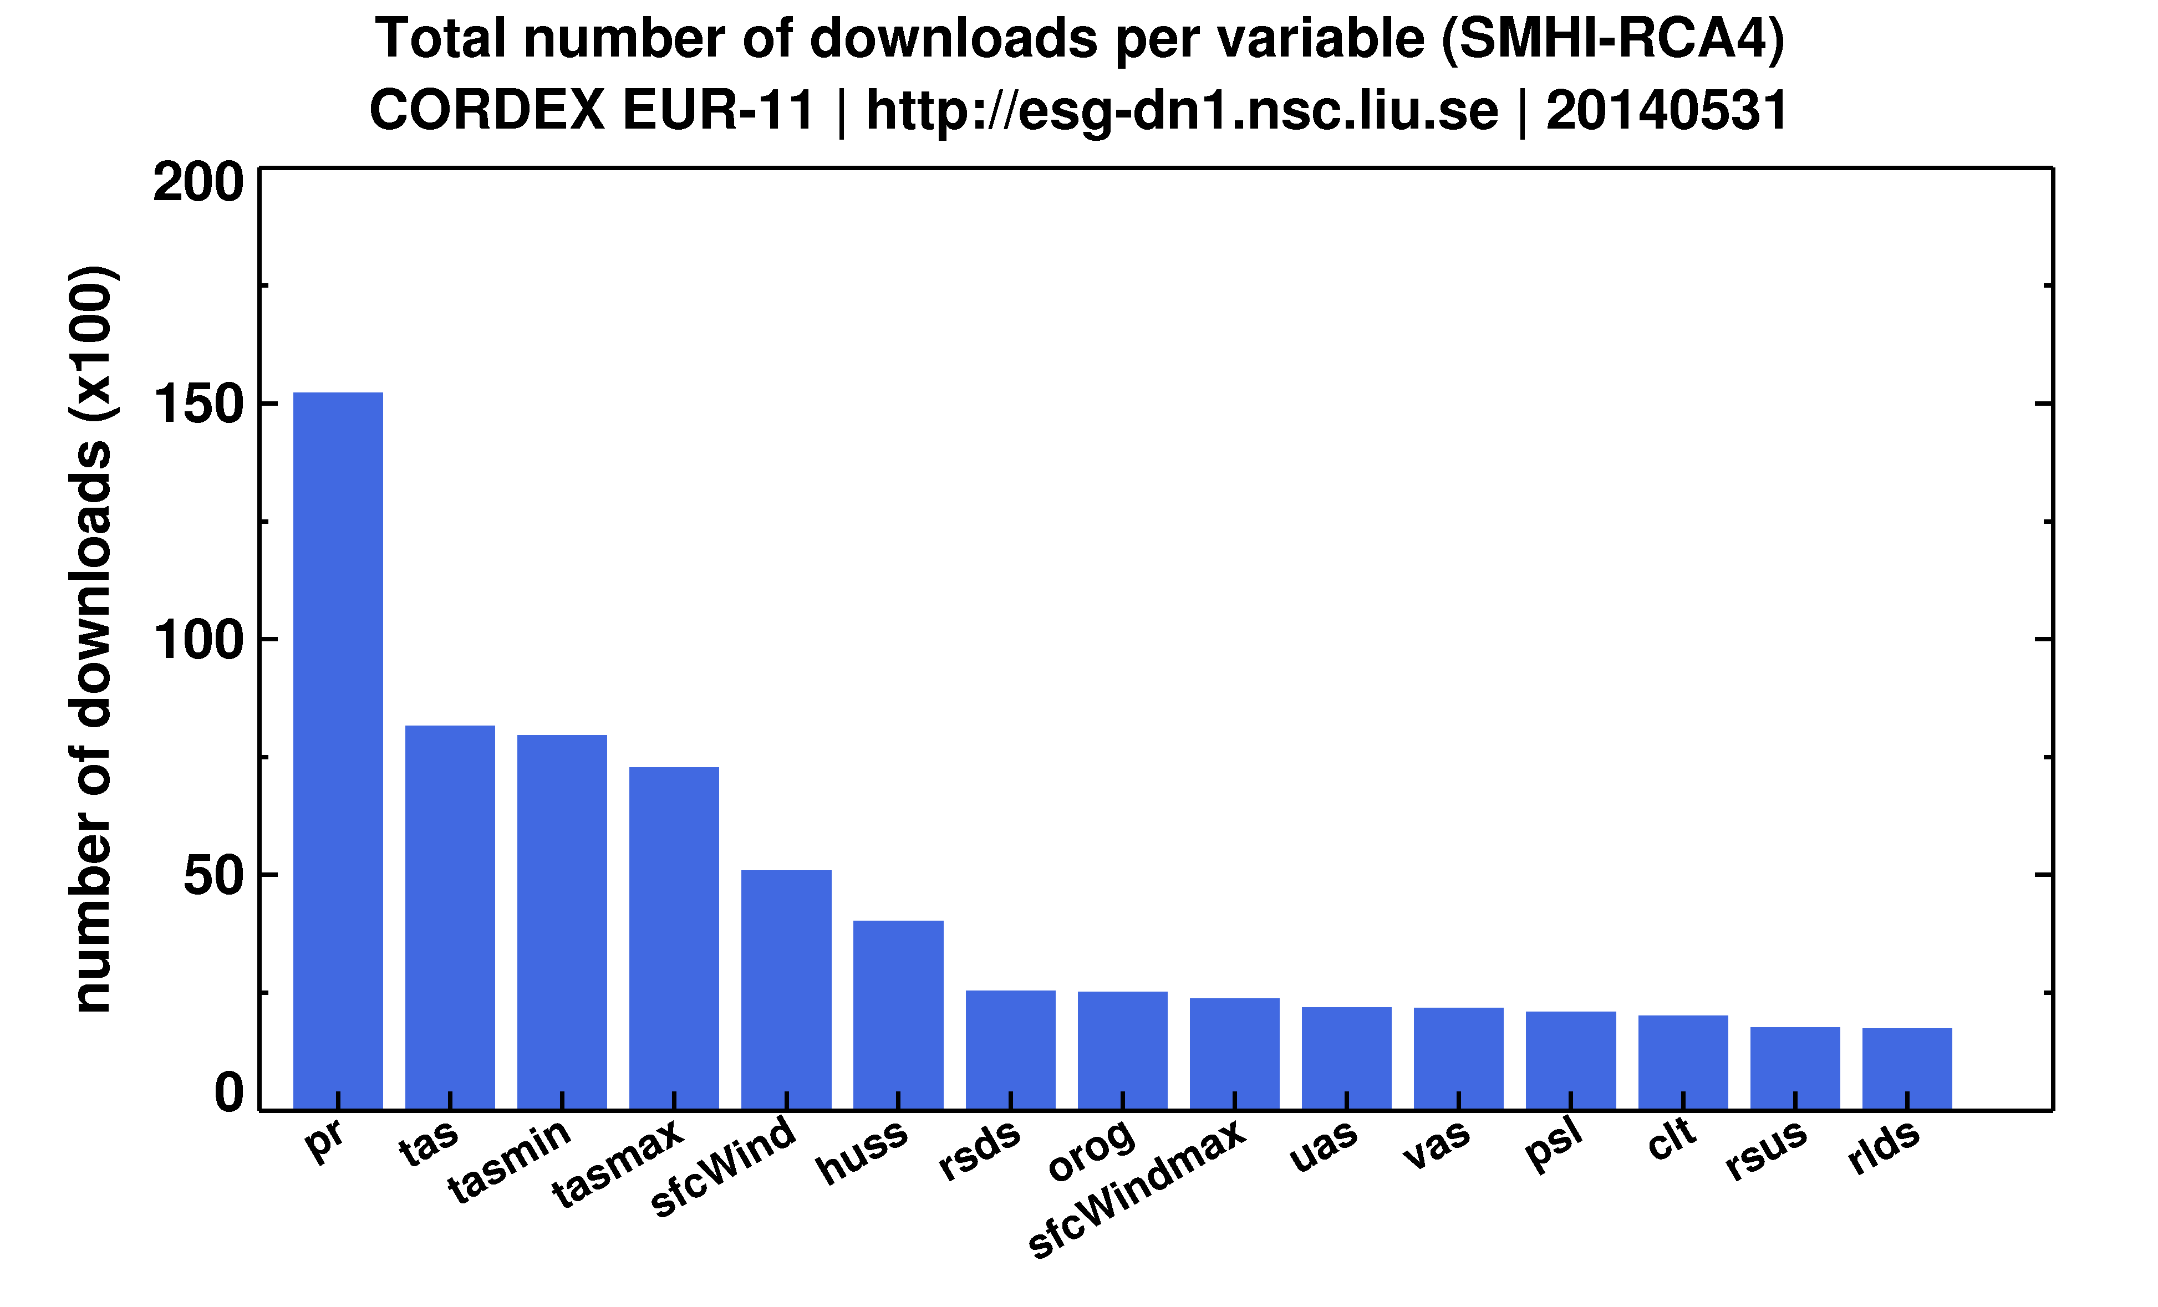
Euro-CORDEX downloads (EUR-11)
Most popular variables: precipitation (favourite), mean, minimum, maximum temperature and specific humidity

Slide 15
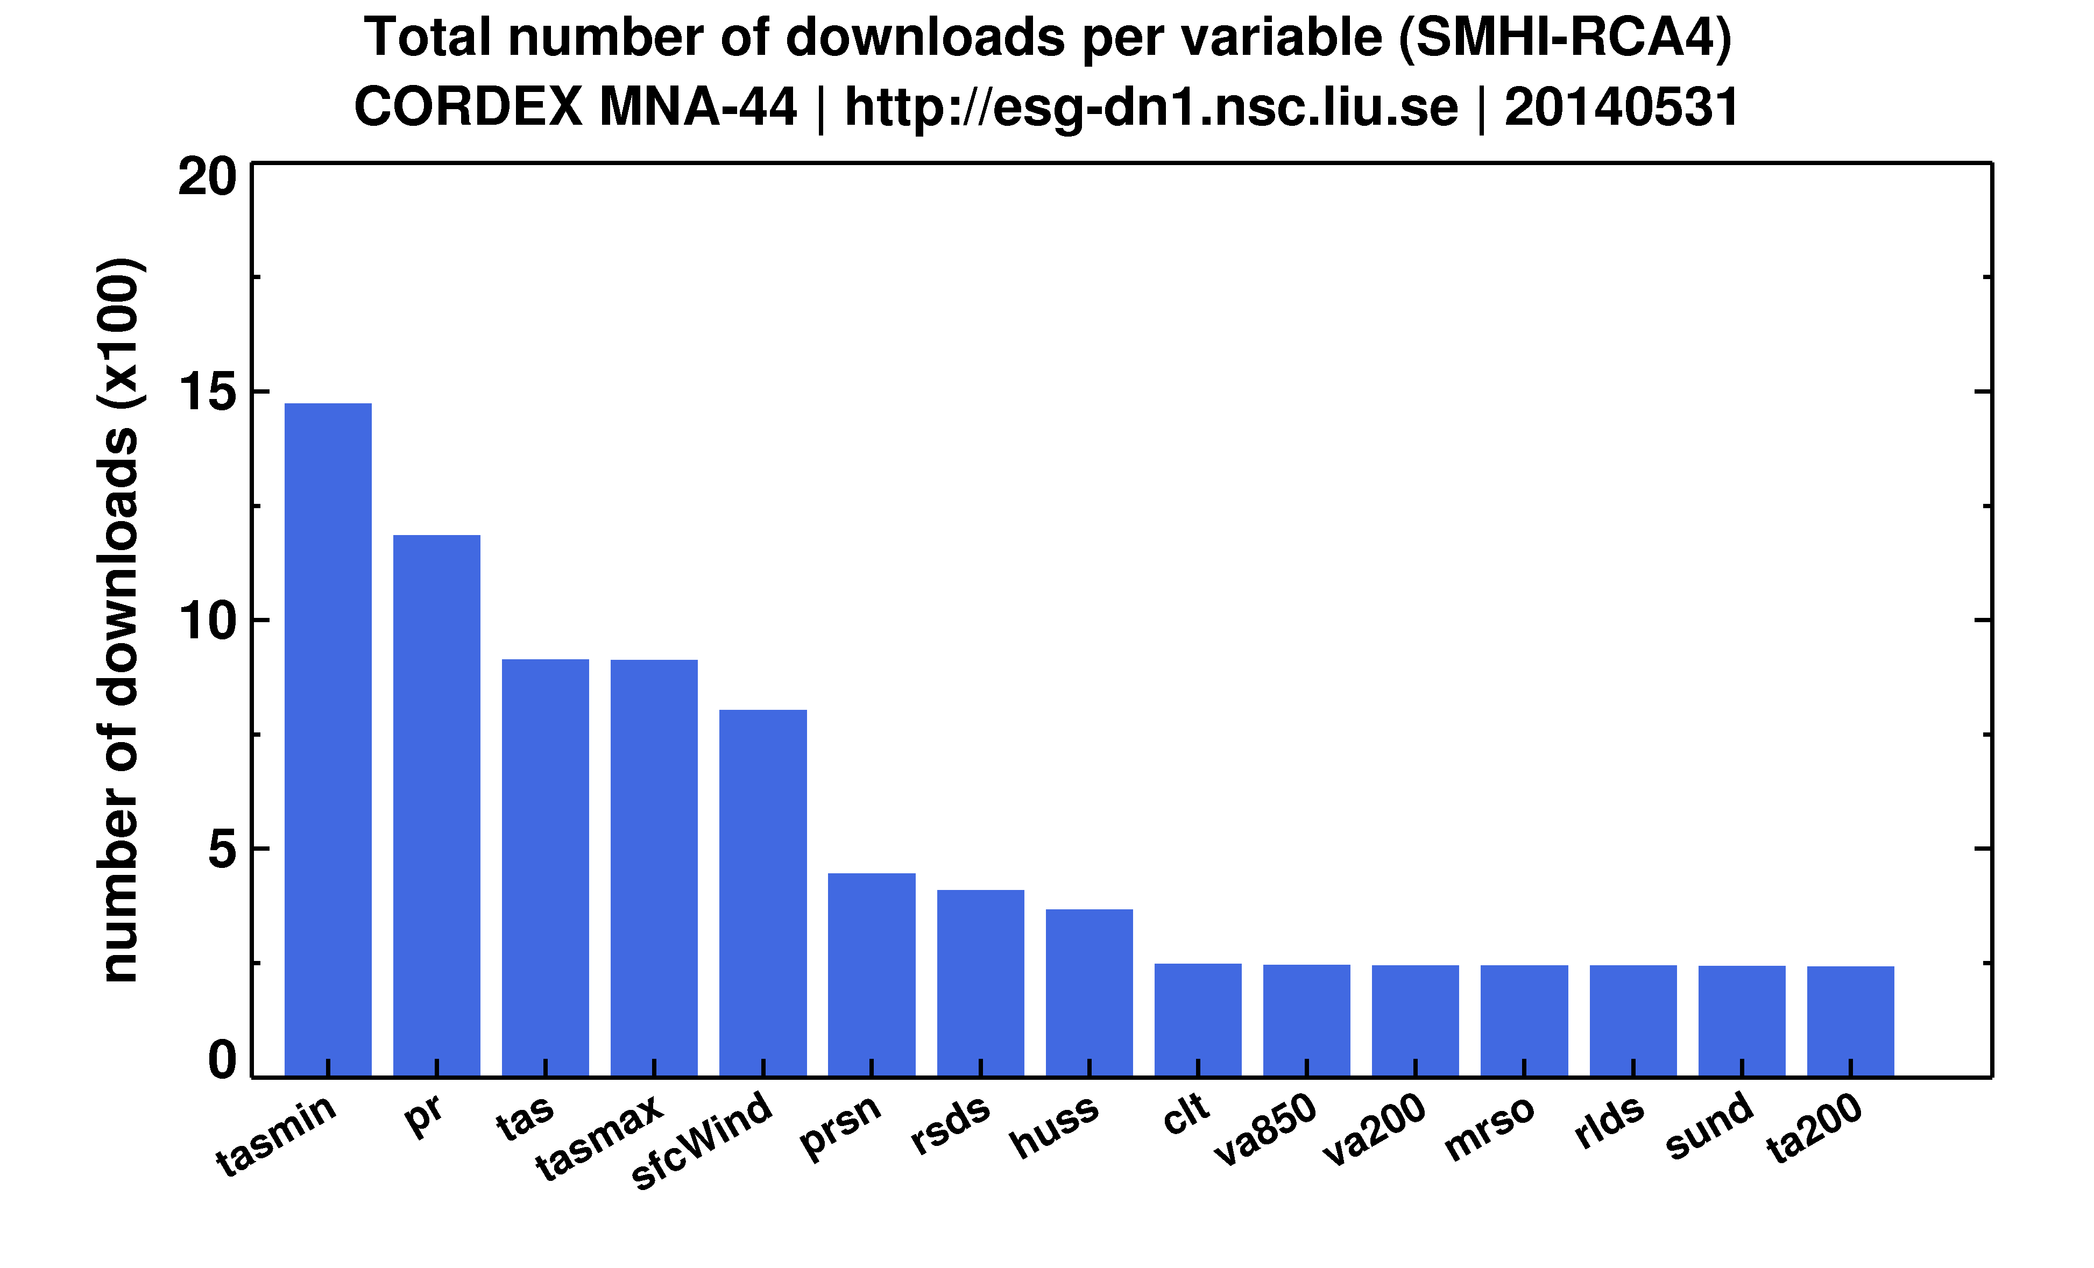
MENA-CORDEX downloads (MNA-44)
Most popular variables: minimum temperature, precipitation, mean, maximum temperature and wind
User needs: minimum temperature is important for agriculture

Slide 16
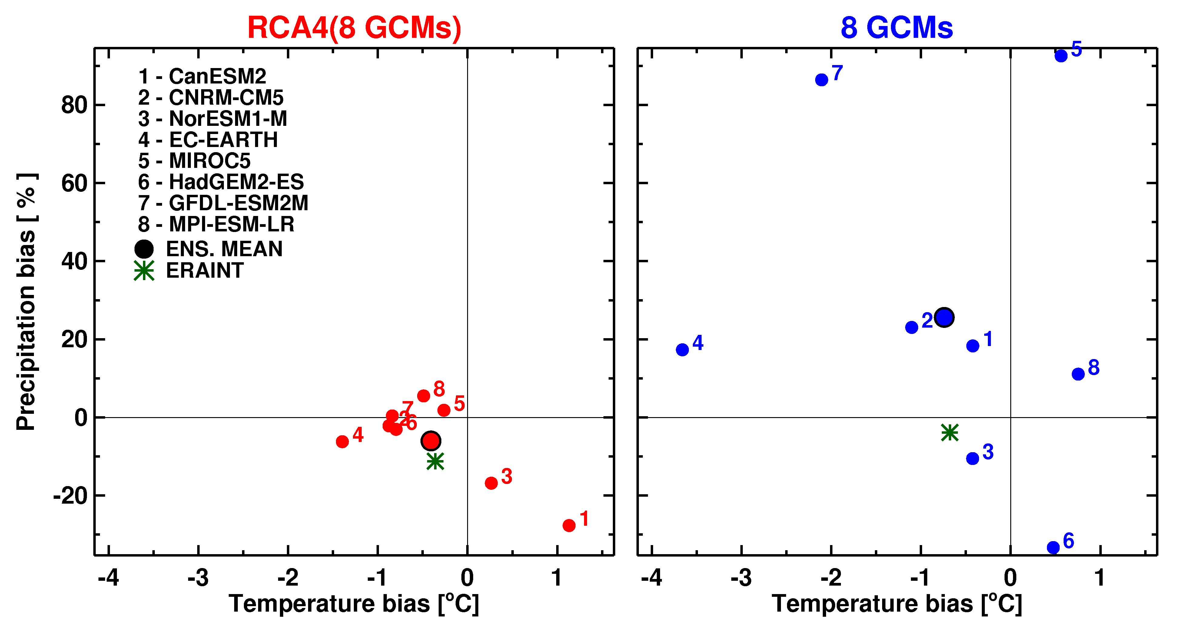
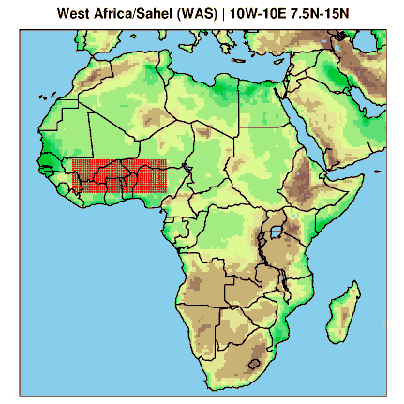
RCA4( 8 GCMs): West Africa
Difference wrt CRU (JAS, 1980-2008)
Over West Africa downscaling by RCA4 reduces GCM biases to an attractor defined by RCA4 climatology

Slide 17
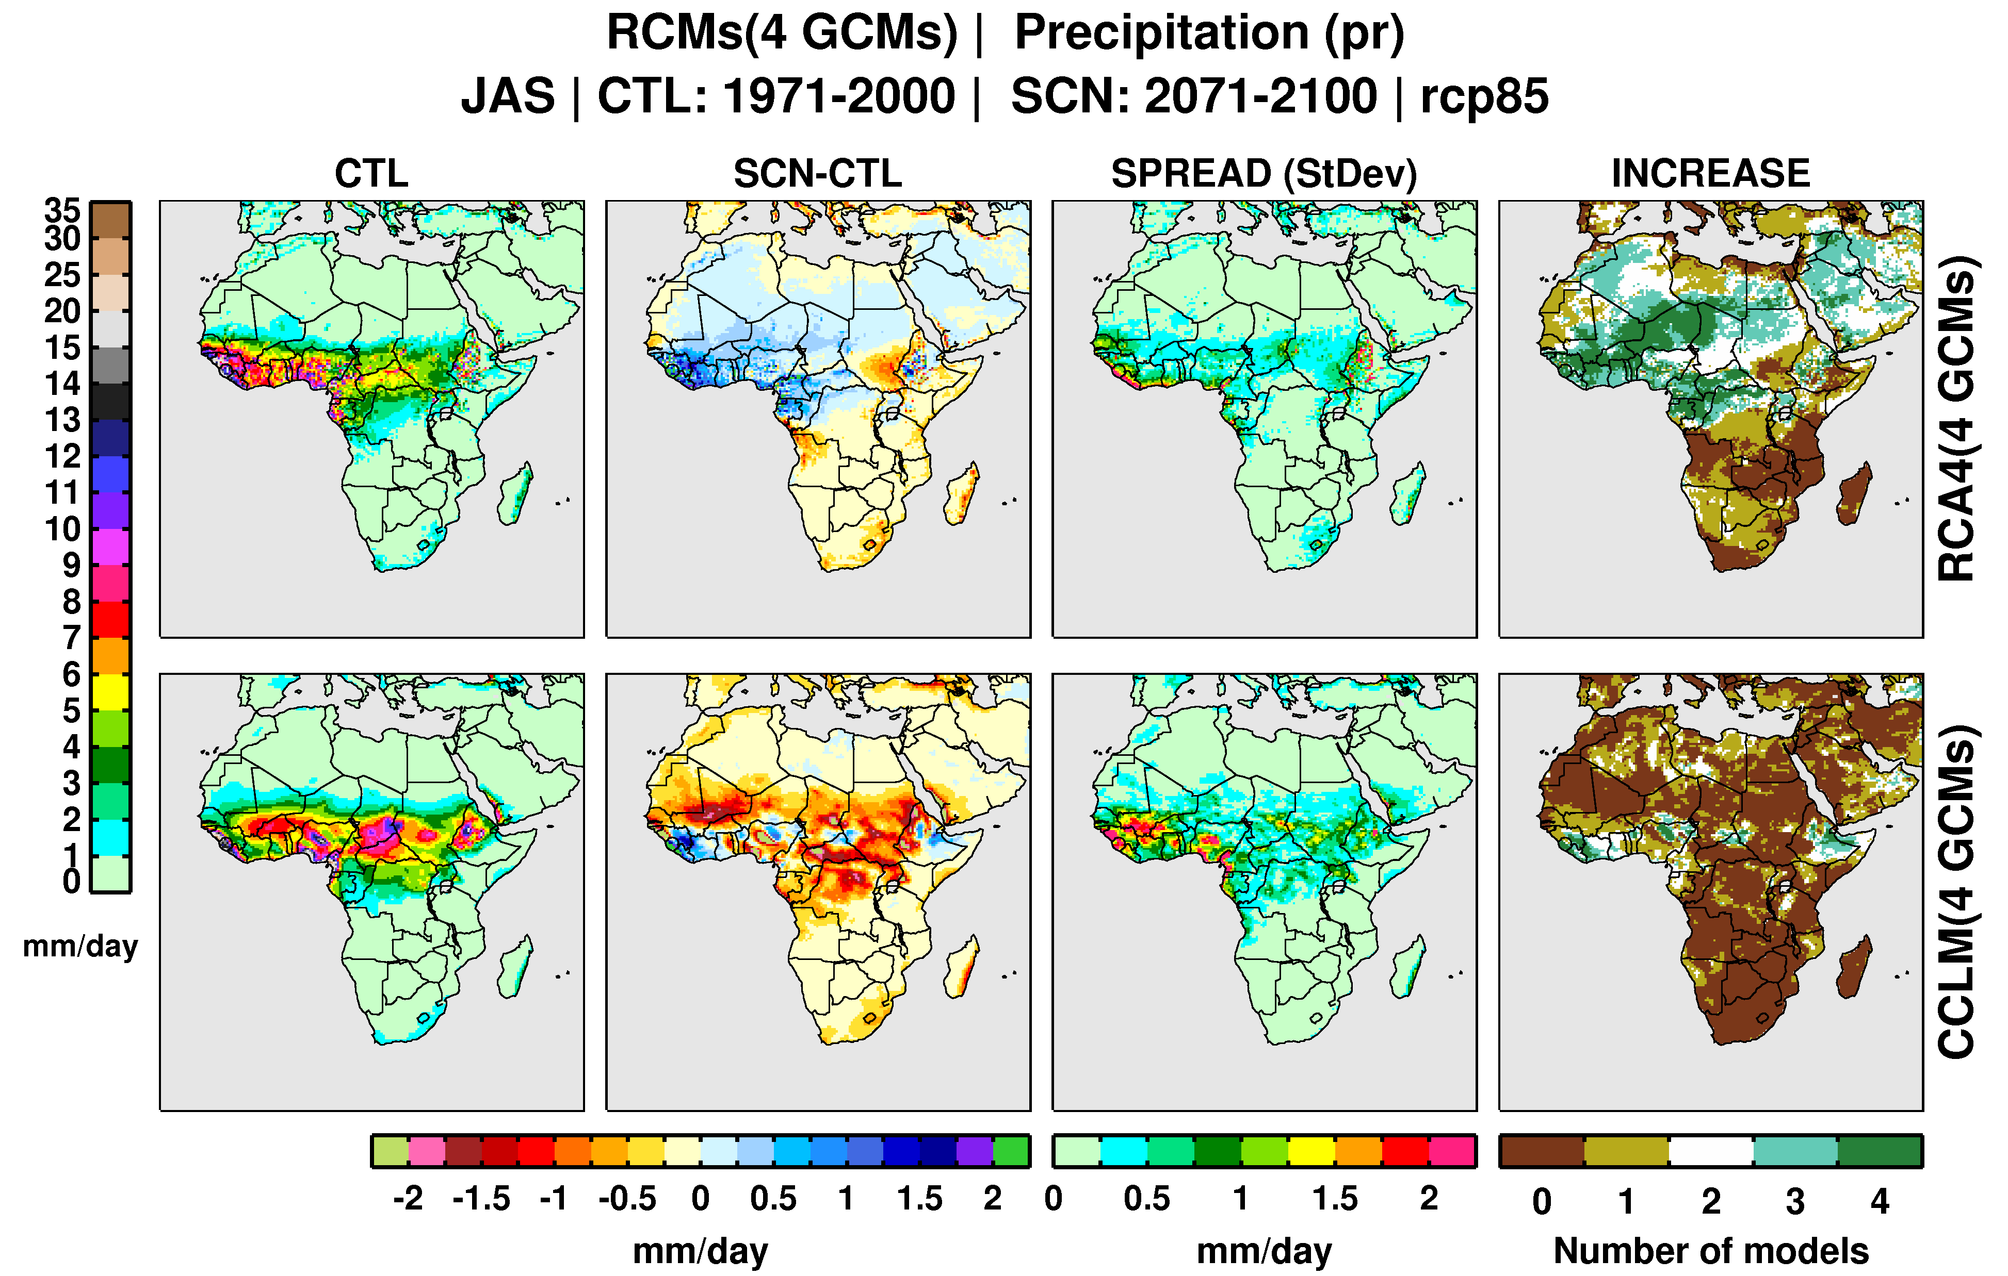
West Africa: climate projections in rainfall
RCA4 (4 GCMs) and CCLM (4 GCMs) JAS
wetter conditions in West Africa in the RCA4 ensemble
mostly drier conditions in the CCLM4 ensemble

Slide 18
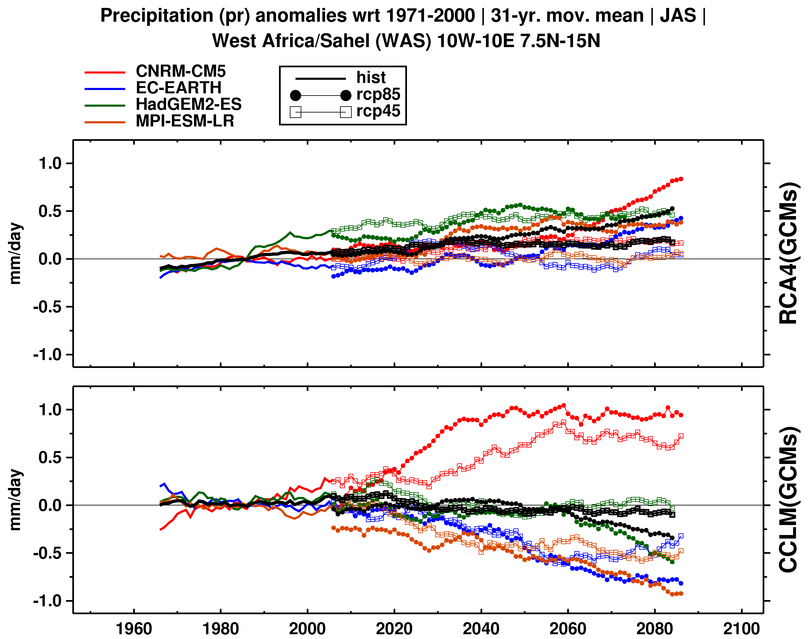
West Africa: climate projections in rainfall
RCA4 (4GCMs) and CCLM (4 GCMs) JAS
31-yr moving average
different signals in sumulations driven by the same GCM

Slide 19
High-resolution observations: Europe
about 50km (0.44°) - recommended resolution in CORDEX
Euro-CORDEX - about 12km (0.11°); the earlier projects PRUDENCE – 50km and ENSEMBLES – 25km
the most popular pan-European daily gridded dataset - EOBS (ECA&D) at 50 and 25km (mean/max/min temperature, precipitation and SLP)
No pan-European gridded observations at 12km (0.11°)
Evaluation of regional climate models at 12km ?
Bias correction of Euro-CORDEX simulations at 12km?
A few high-resolution national gridded datasets available: Norway (1km), Switzerland (2km), Sweden (4km), Germany (from 1 to 10 km), Spain (10km), ….
Detailed evaluation of RCMs is limited by available national gridded hi-res observations

Slide 20
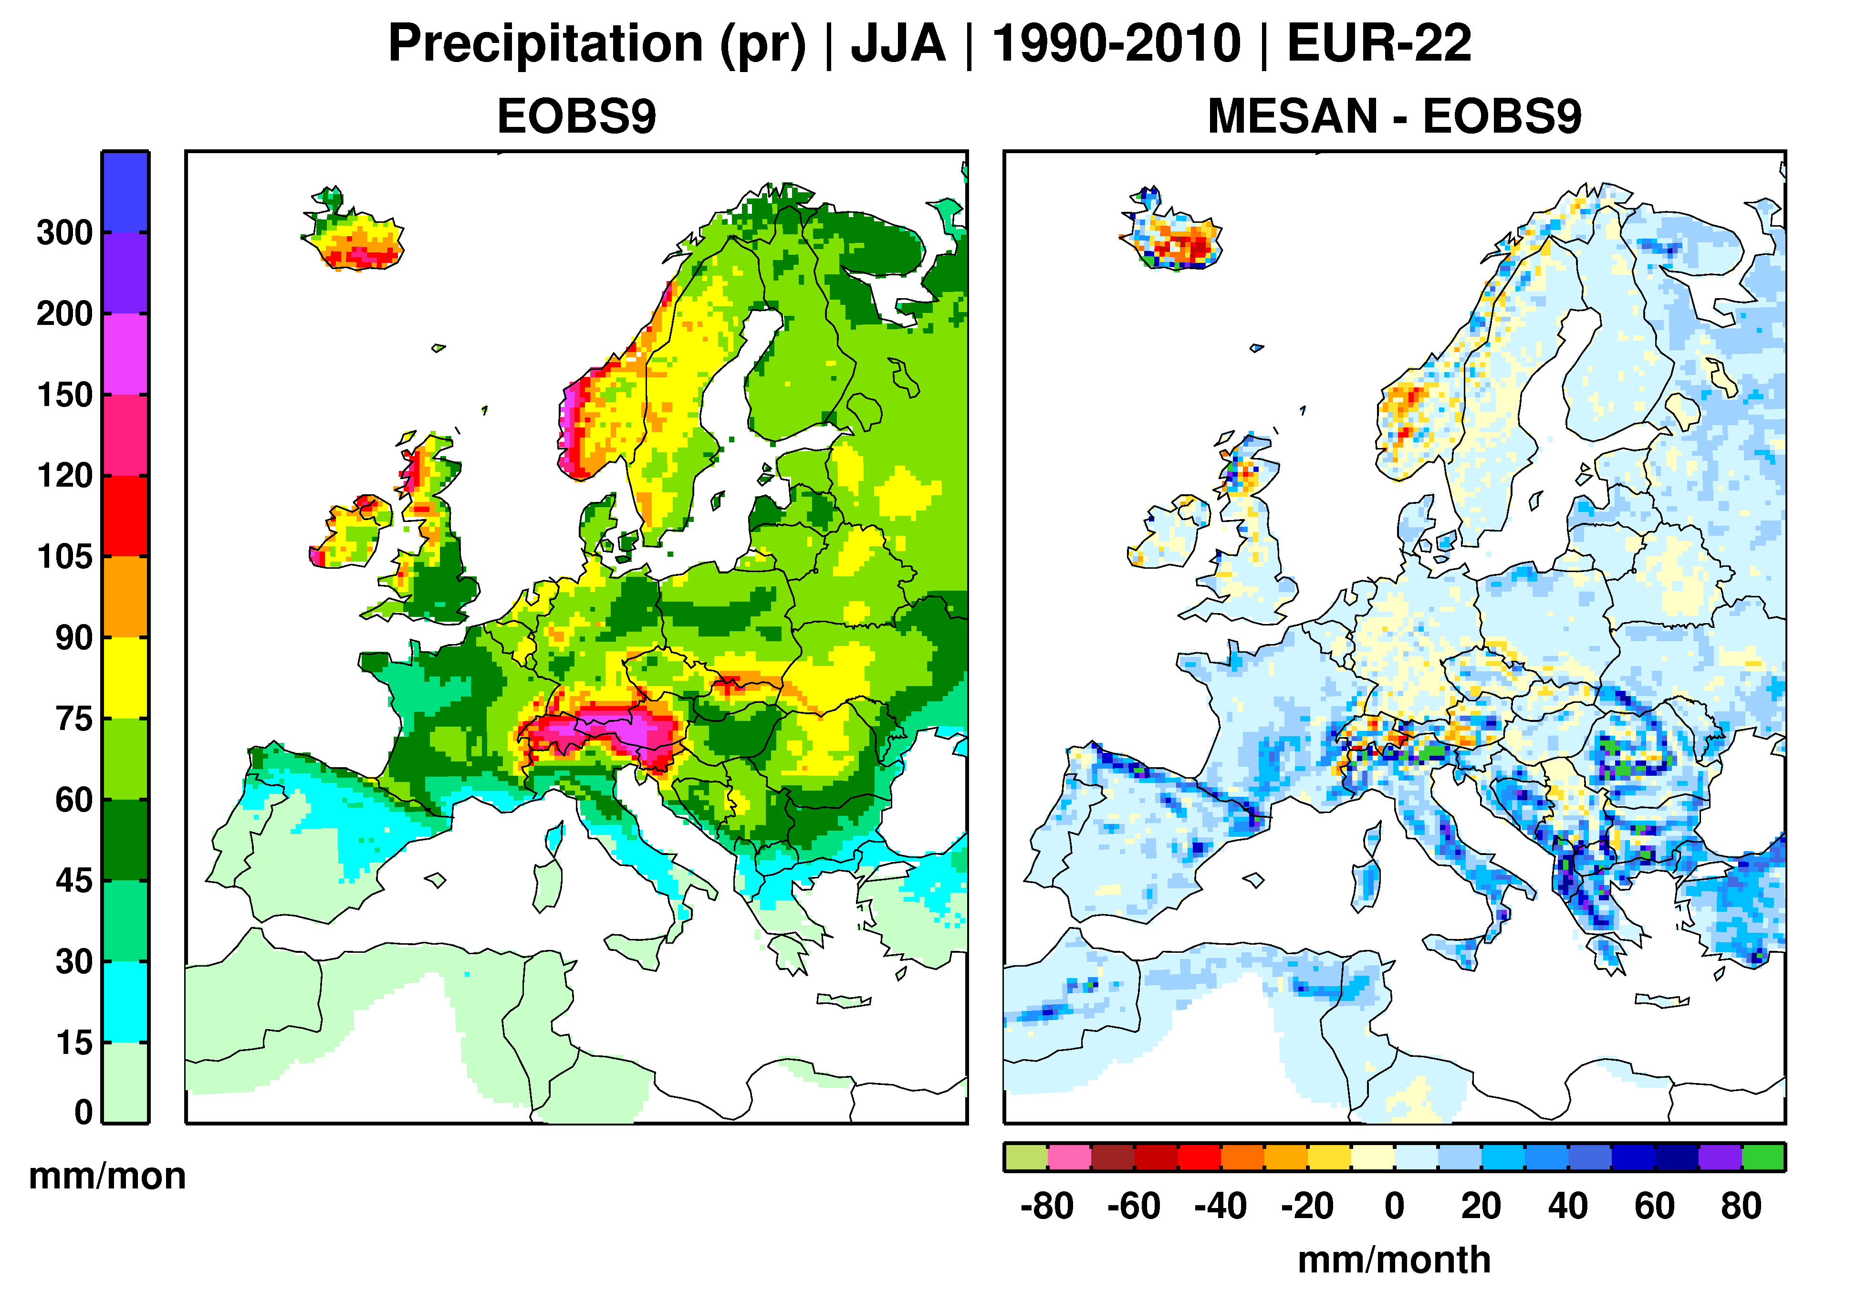
EURO4M: Regional reanalysis
EURO4M - The European Reanalysis and Observations for Monitoring (EU funded project)
One product - Regional reanalysis at about 25 and 5km resolution
1) Era-Interim is downscaled by SMHI-HIRLAM (0.75 to 0.22°, 3DVAR)
2) SMHI-HIRLAM is downscaled by SMHI-MESAN (8 near-surface
variables, 2D optimal interpolation, 0.22 ° to 0.05°, 1991-2010)

Slide 21
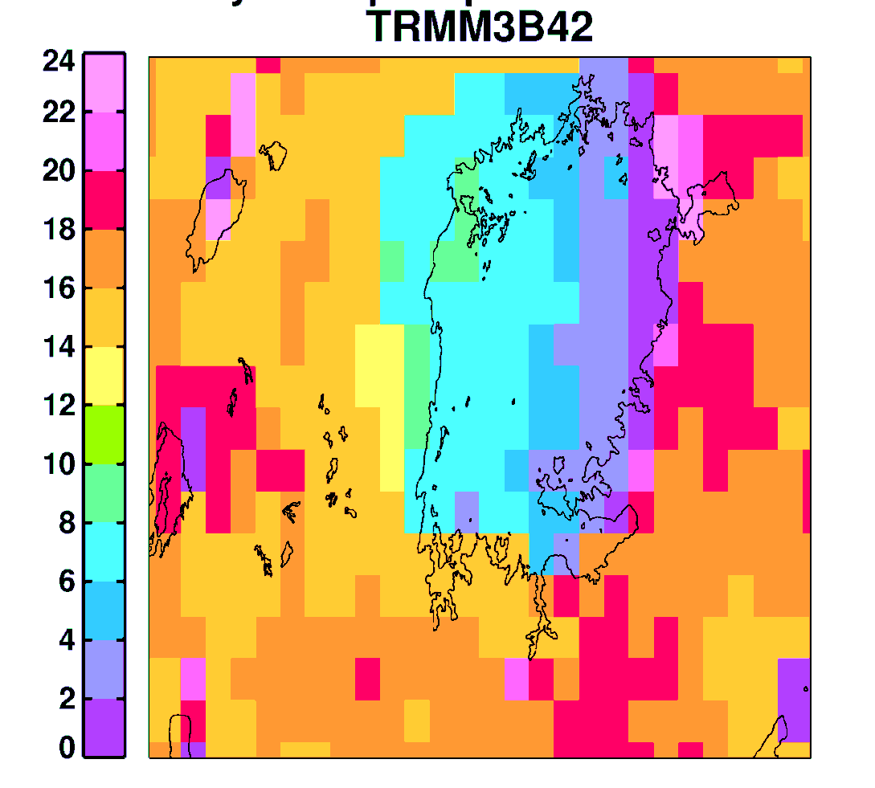
Africa: a challenging region
many precipitation gridded datasets are available at different spatial and temporal resolutions (about 20)
large differences can be found across different datasets at regional scale
satellite-based datasets often use the same gauge products for calibration (not independent)
the need of not only spatially high resolution but also of temporal one
TRMM3B42 (3-hr, 0.25°):
Local solar time of maximum precipitation intensity during the diurnal cycle for April-June (2003–2008) near the Lake Victoria in eastern Africa
afternoon maximum over land
late evening-earlier morning maximum over the Lake

Slide 22
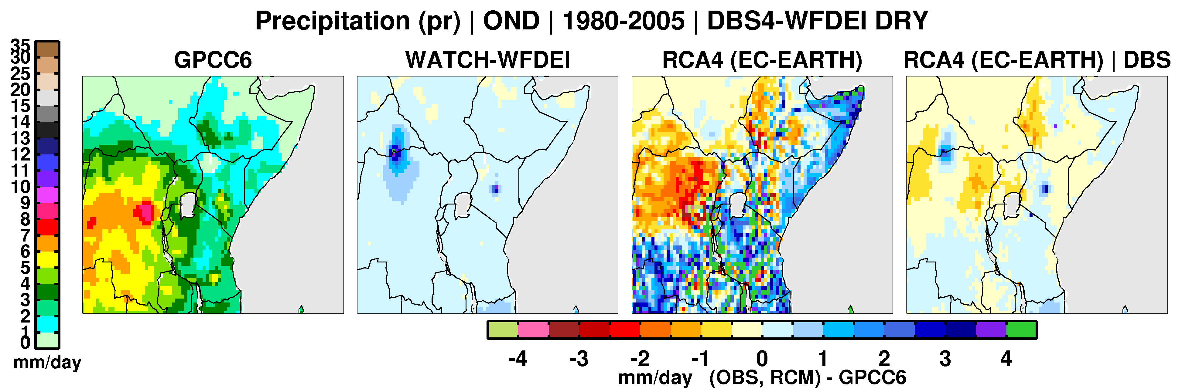
Bias correction over Africa
WATCH Forcing Data ERA-Interim (WFDEI): 3-hr ERA-Interim is interpolated from about 0.75° to 0.5° and bias corrected using monthly climatology from CRU or GPCC (1979-2012)
only one dataset providing a few daily variables globally
widely used for bias correction of global and regional models
Bias correction of a CORDEX-Africa simulation using the Distribution Based Scaling method (DBS)
WFDEI locally can differ from GPCC6 (edges of the ITCZ rain belt)

